Slide 1
Sign Language Recognition
and Text to Speech Conversion
Md Kausar Islam Bidhan
ID: 19301156
Sadia Yesmin
ID: 19301202

Slide 2
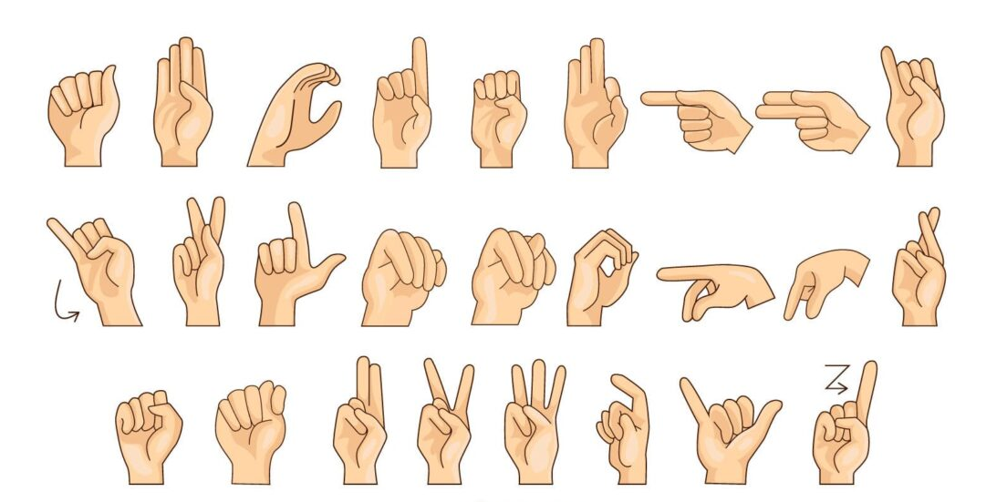

Slide 3
The Abstract
Enhancing Communication Accessibility
Overcoming Interpreter Shortage: Developing a Neural Network-Based Solution
High Accuracy and Gesture Categorization

Slide 4
The Introduction
Empowering DM Individuals
Beyond Verbal Language: The Importance of Nonverbal Communication
Creating Wholesome Communication: Forming Words through Sign Language
Building a Comprehensive Recognition Model: Recognizing Hand Movements for Fingerspelling

Slide 5
Motivation
Bridging the Communication Gap
Empowering DM Individuals: Creating User-Friendly Human-Computer Interfaces
A World of Diverse Sign Languages: Understanding and Comprehending ASL, BSL, ISL, and More

Slide 6
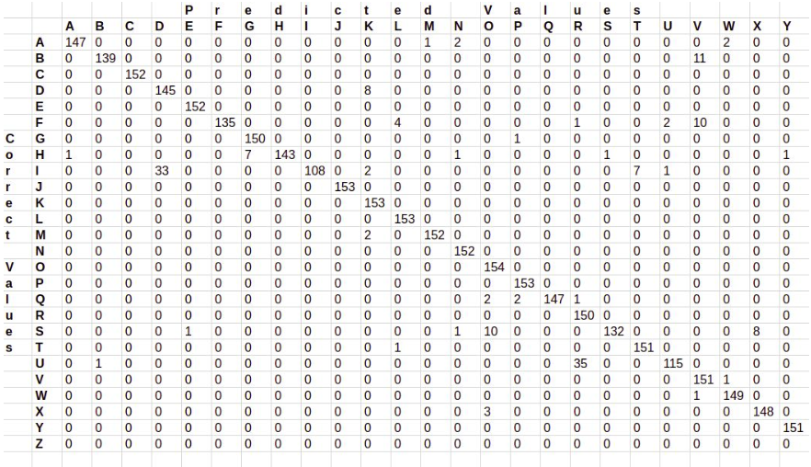
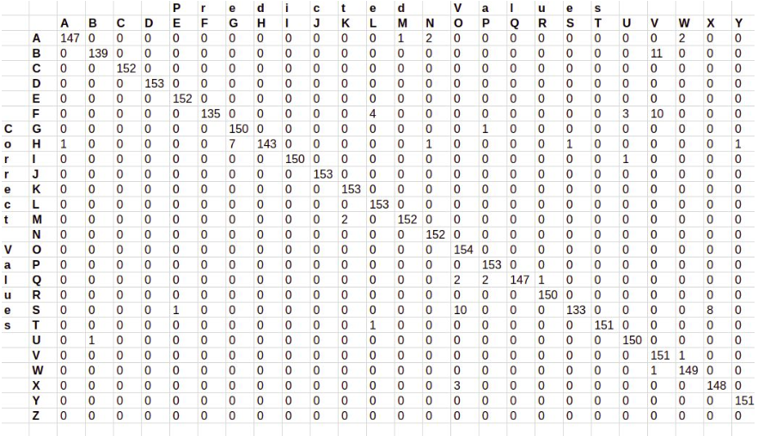
Methodology
Asl symbols
CNN model architecture
Adam optimizer

Slide 7
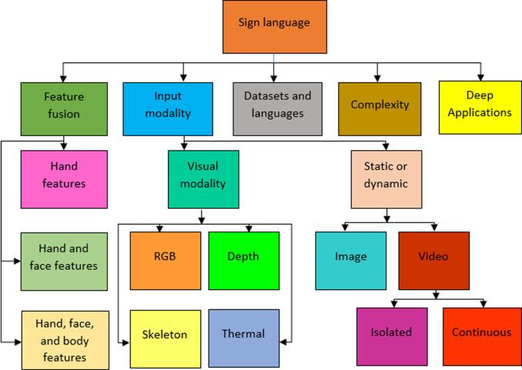
Results
98.0% accuracy when layers 1 and 2 are combined
95.8% accuracy with just layer 1

Slide 8
Discussion and Conclusion
Development of Real-Time ASL Recognition System for DM Individuals
Achieving 98.0% Accuracy Rate on ASL Alphabet Recognition
Enhancing Prediction with Two Layers of Algorithms in ASL Recognition

